Slide 1



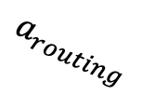

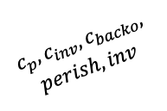
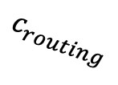

Policy Evaluation
Policies
Routing
Routing
$$a_{routing}$$
Environment
$$a_{t}$$
Purchasing
Transition blocks
$$c_{routing}$$
Policies
$$c_{p},c_{inv},c_{backo},$$
$$perish, inv$$
$$s_{t}$$
Inventory Management
Inventory management
$$a_{purch,inv,dem}$$
$$params$$
$$params$$
Instance generator
Instance generation
Locations
Offer
Demand
Costs

